Slide 1
Method Invocation Pattern in JavaScript
Name: Ritik Sharma

Slide 2
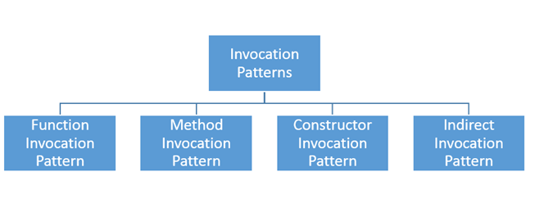
Types of Method Invocation Pattern in JavaScript

Slide 3

Function Invocation Pattern:
When Function is called as Function.
The value of 'this' here is Global Object like Nodejs and in Browser window is global object.

Slide 4

Constructor Invocation Pattern:
When call a function with 'new'
The value of 'this' is newly created object.
'return' has no value here.

Slide 5
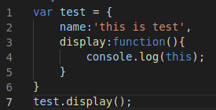
Method Invocation Pattern:
Invoked using dot ('.') operator on object.
The value of 'this' depends on the object before dot ('.') operator.

Slide 6
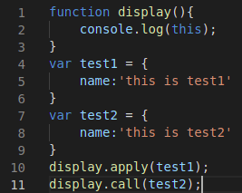
Indirect Invocation Pattern:
3 ways to do-
Apply() method
Bind() method
Call() method
We pass objects indirectly in other object function.

Slide 7
Thank You

